Slide 1
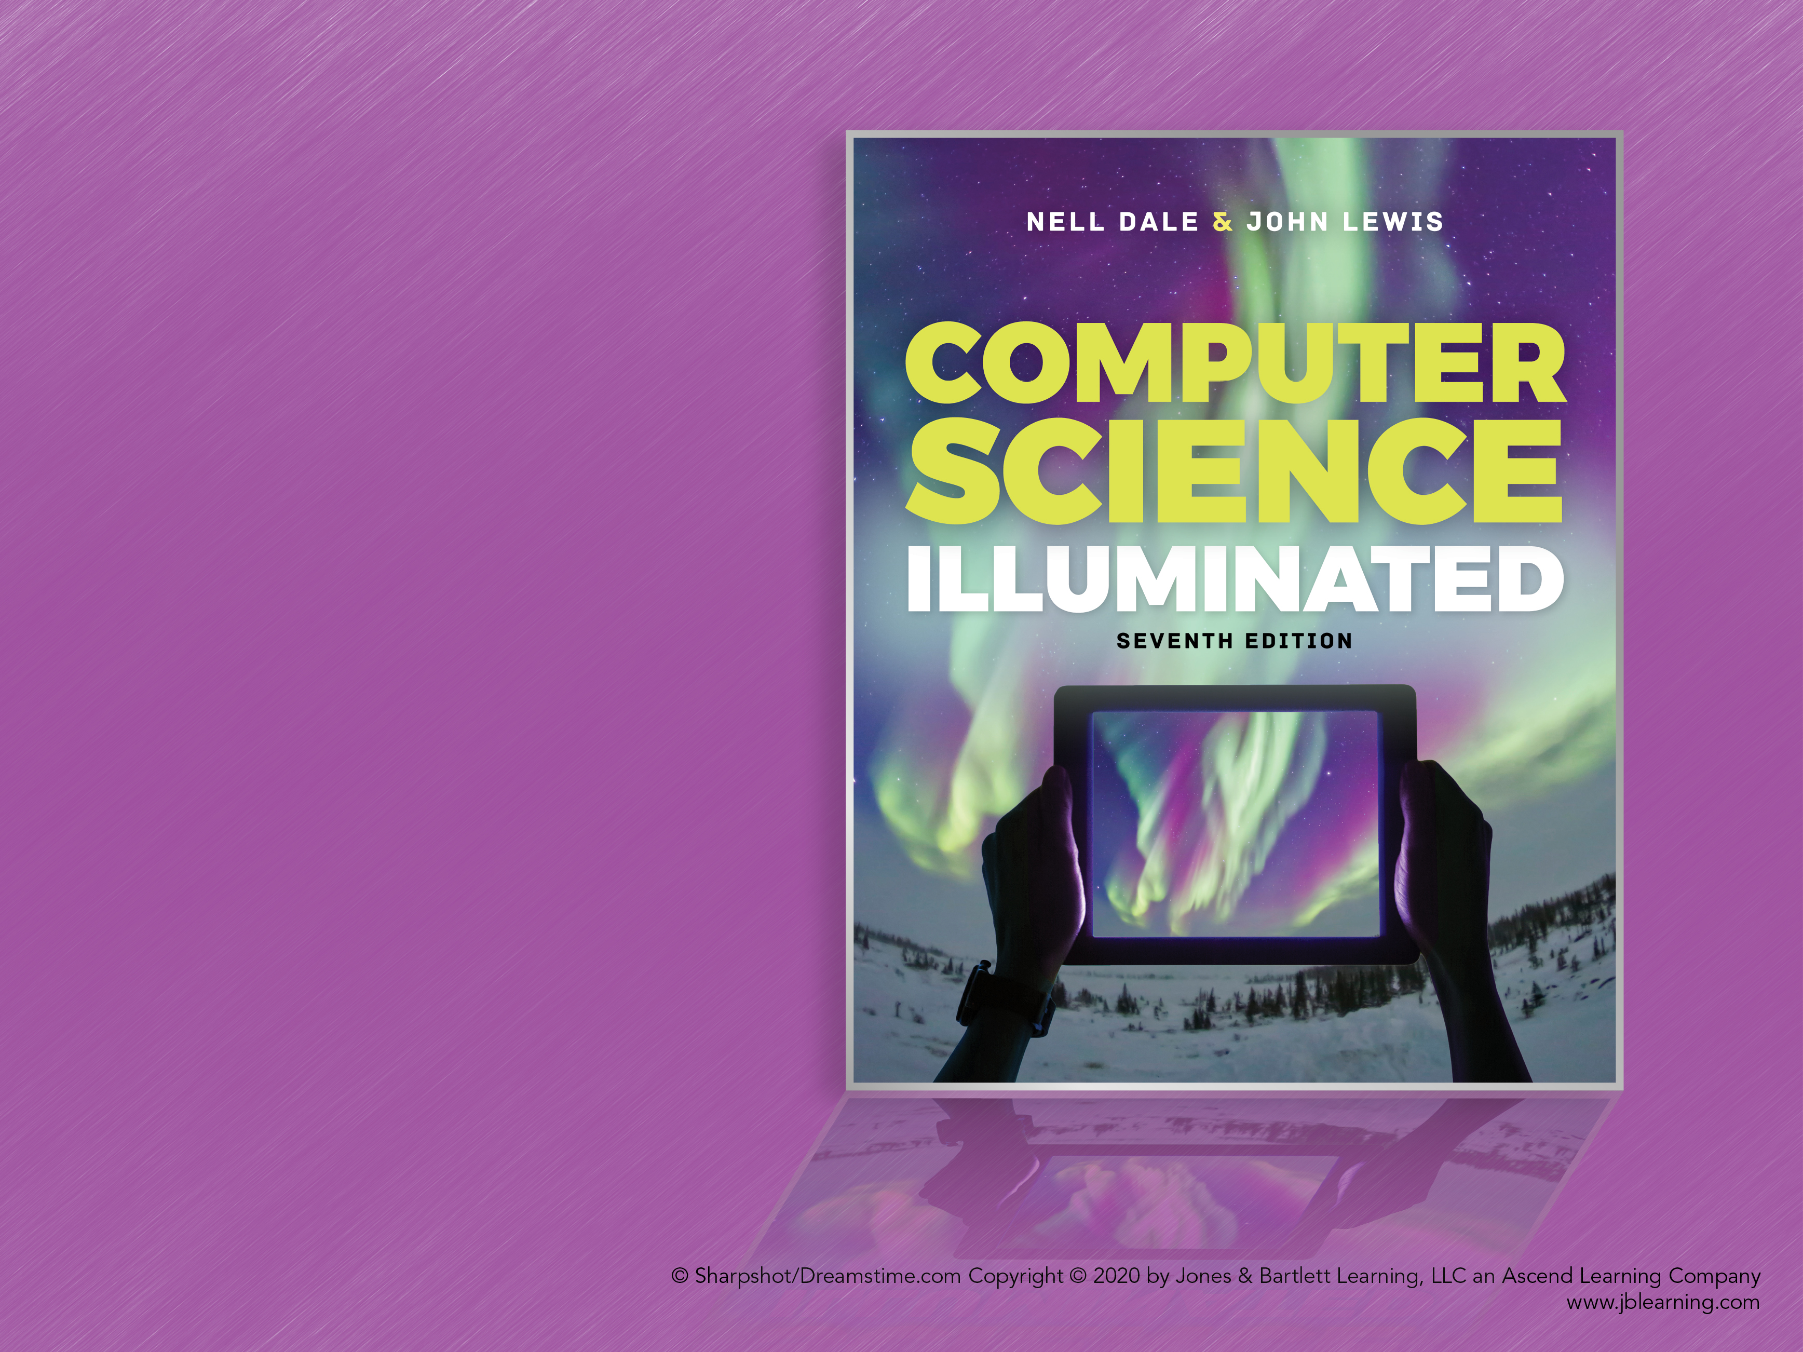
Chapter 5
Computing Components

Slide 2
Chapter Goals (1 of 2)
Read an ad for a computer and understand the jargon
List the components and their function in a von Neumann machine
Describe the fetch-decode-execute cycle of the von Neumann machine
Describe how computer memory is organized and accessed

Slide 3
Chapter Goals (2 of 2)
Name and describe different auxiliary storage devices
Define three alternative parallel computer configurations
Explain the concept of embedded systems and give examples from your own home

Slide 4
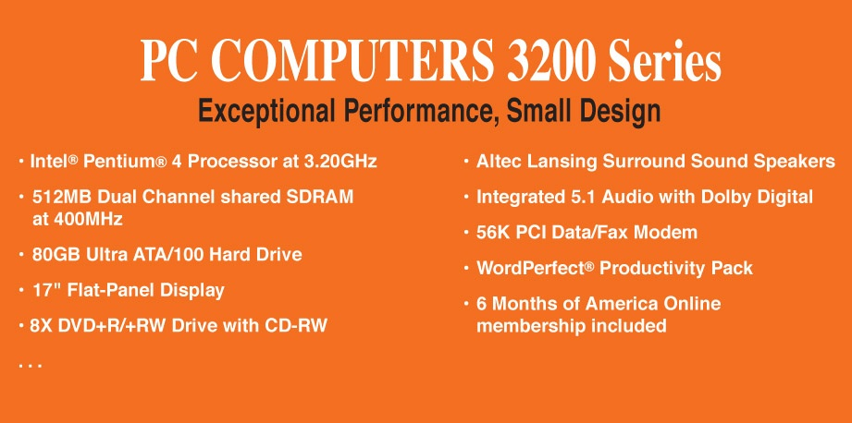
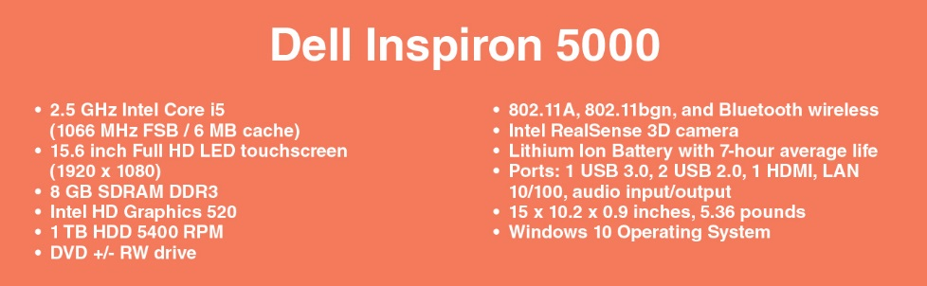
Computer Components
Consider the following computer specification:

Slide 5
Sizes in Perspective (1 of 3)
Admiral Grace Murray Hopper’s illustration
A coil of wire nearly 1,000 feet long
Distance traveled by an electron along the wire in the space of a microsecond
A short piece of wire
In the space of a nanosecond
A bag containing grains of pepper
In the space of a picosecond

Slide 6
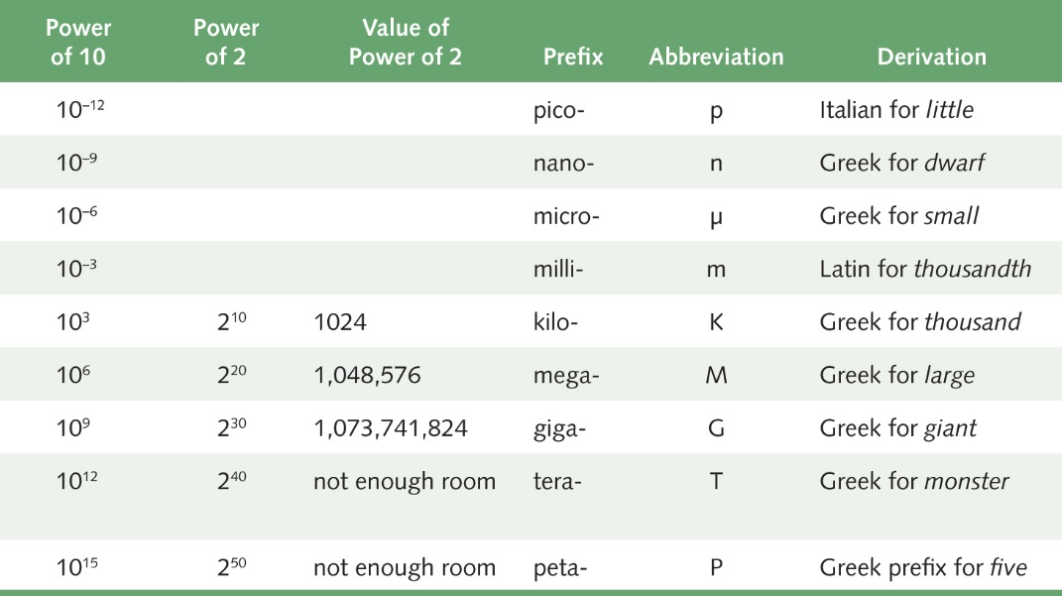
Sizes in Perspective (2 of 3)
Powers of 10 for time, powers of 2 for storage

Slide 7
Sizes in Perspective (3 of 3)
Intel Processor
Speed 2.66 GHz
SDRAM
Size 4GB
Speed 800 MHz
500GB SATA at 5400 RPM
Transfer rate 300MB per second
Flat screen dot pitch .28mm
To which do these apply?
Bigger is better
Faster is better
Smaller is better

Slide 8
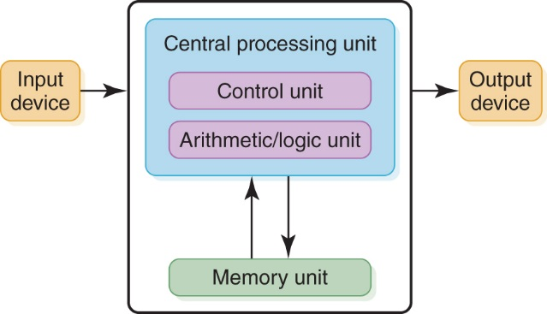
Stored-Program Concept
The von Neumann architecture
Instructions and data are both stored in memory unit

Slide 9
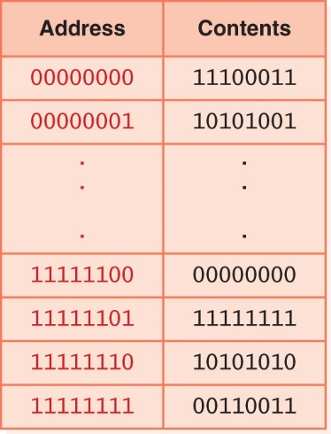
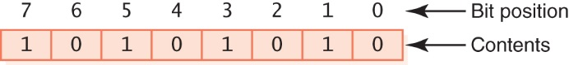
Memory (1 of 2)
Memory
A collection of cells, each with a unique physical address
Most computers are byte-addressable
Cell at address 11111110 contains 10101010
“Little endian” bit numbering:

Slide 10
Memory (2 of 2)
Memory
What does 10101010 mean?
No way to answer that without applying an interpretation.
Could be an instruction, a natural number, a signed integer, a character, part of an image, …

Slide 11
Arithmetic/Logic Unit
Performs basic arithmetic operations such as addition and subtraction
Performs logical operations such as AND, OR, and NOT
Most modern ALUs have a small amount of special storage units called registers that can be accessed faster than main memory

Slide 12
Input/Output Units
Input Unit
A device through which data and programs from
the outside world enter the computer system
Can you name three?
Output Unit
A device through which results stored in the
computer memory are made available outside the computer system
Can you name two?

Slide 13
Control Unit
Control Unit
The organizing force in the computer
Instruction Register (IR)
Contains the instruction that is being executed
Program Counter (PC)
Contains the address of the next instruction to be
executed
Central Processing Unit (CPU)
ALU and the control unit called the Central Processing Unit, or CPU

Slide 14
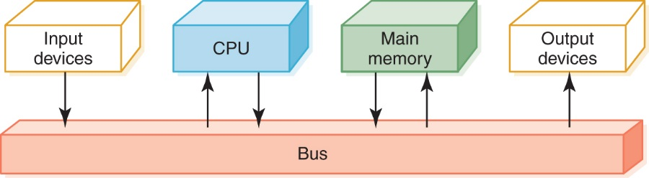
Flow of Information
Bus
In general: A communication system that transfers data between components inside a computer or between computers; the medium (wires, optical fiber, etc.) and the protocols (rules for sharing the medium nicely)
“The” bus: Connects the CPU, main memory, I/O devices, and possibly other components (e.g., hard disk drive)
Data flow through a von Neumann machine

Slide 15
What is an N-bit Processor?
It could mean any of these:
N-bit general registers
N-bit ALU
N-bit addresses
N-bit data bus

Slide 16
The Fetch-Execute Cycle (1 of 2)
Fetch the next instruction
Decode the instruction
Get data if needed
Execute the instruction
Why is it called a cycle?

Slide 17
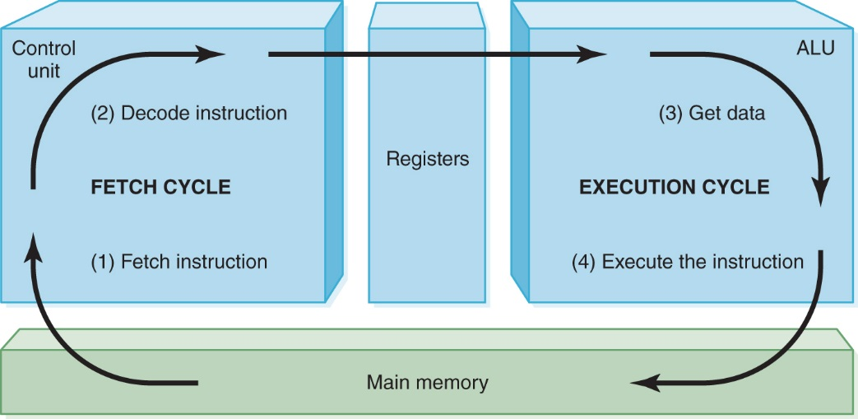
The Fetch-Execute Cycle (2 of 2)
The fetch-execute cycle

Slide 18
RAM and ROM
Random Access Memory (RAM)
Memory in which each location can be accessed and changed
Read Only Memory (ROM)
Memory in which each location can be accessed but not changed
RAM is volatile, ROM is not.
What does volatile mean?

Slide 19
Secondary Storage Devices
Why is it necessary to have secondary storage devices?
Can you name some of these devices?

Slide 20
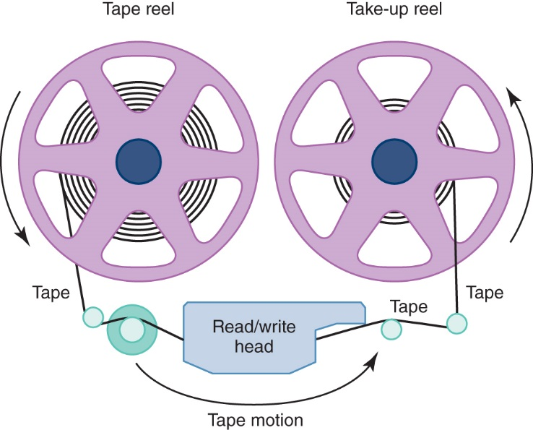
Magnetic Tape
The first truly mass auxiliary storage device was the magnetic tape drive
Tape drives have a
major problem; can
you describe it?
A magnetic tape

Slide 21
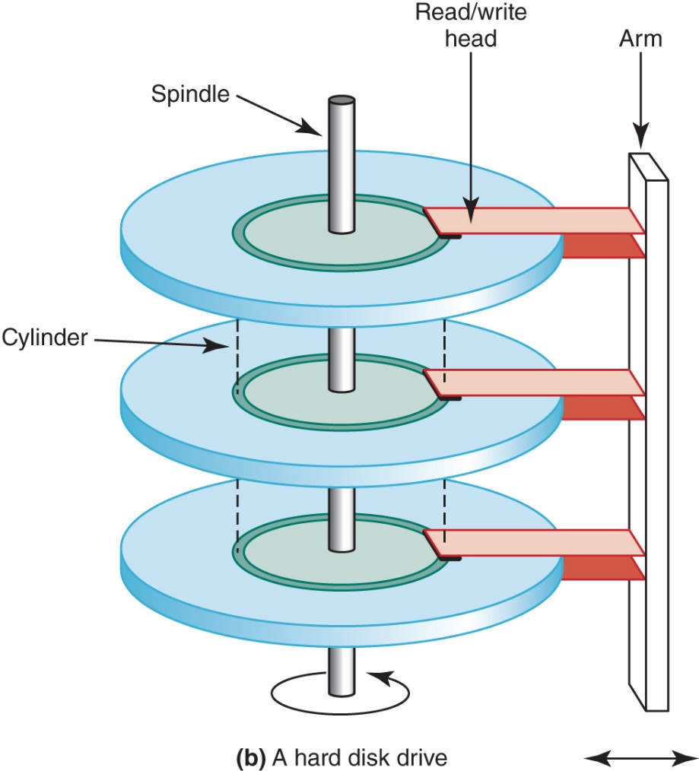
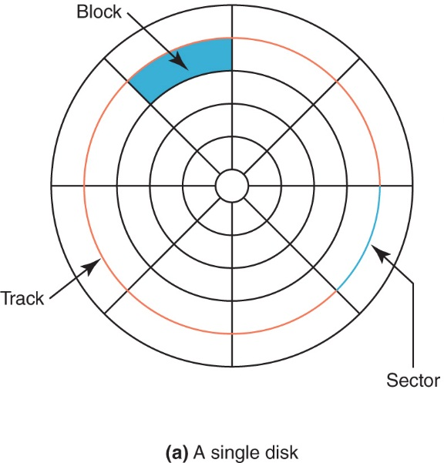
Magnetic Disks (1 of 2)
The organization of a magnetic disk (A) A single disk
The organization of a magnetic disk (b) A hard disk drive

Slide 22
Magnetic Disks (2 of 2)
Seek Time
Time for read/write head to be over right track
Latency
Time for sector to be in position
Access Time
Can you define it?
Transfer Rate
Rate at which data moves from the disk to memory

Slide 23
Optical Disks
CD
A compact disk that uses a laser to read information stored optically on a plastic-coated disk; data is evenly distributed around spiral track
CD-ROM read-only memory
CD-DA digital audio
CD-WORM write once, read many
RW or RAM both read from and written to
DVD
Digital Versatile Disk, used for storing audio and video
Blu-ray
Higher capacity DVD allowing higher resolution video, etc.

Slide 24
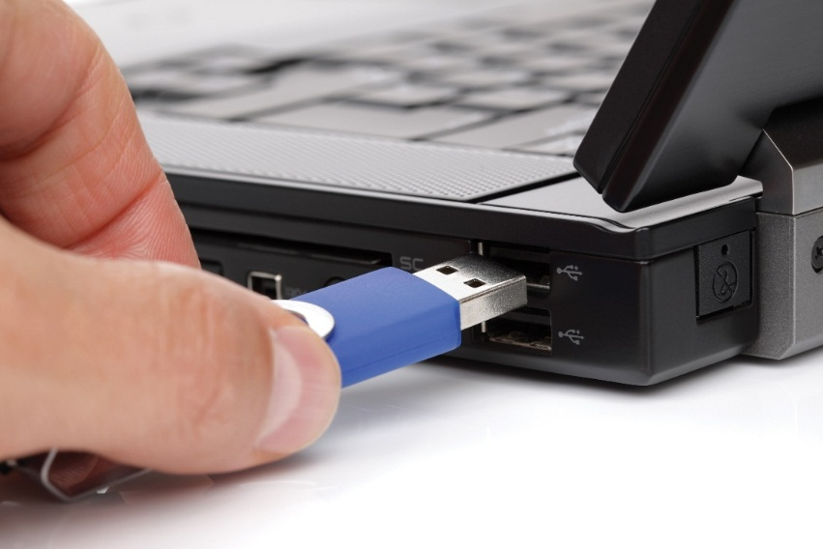
Flash Drives
Flash Memory
Nonvolatile
Can be erased and rewritten
Supports USB mass storage standard
© Brian A. Jackson/Shutterstock
Flash drive
24
Notes:
24

Slide 25
Touch Screens (1 of 5)
Touch Screen
A computer monitor that can respond to the user touching the screen with a stylus or finger
There are four types
Resistive
Capacitive
Infrared
Surface acoustic wave (SAW)

Slide 26
Touch Screens (2 of 5)
Resistive Touch Screen
A screen made up of two layers of electrically conductive material
One layer has vertical lines, the other has horizontal lines
When the top layer is pressed, it comes in contact with the second layer, which allows electrical current to flow
The specific vertical and horizontal lines that make contact dictate the location on the screen that was touched

Slide 27
Touch Screens (3 of 5)
Capacitive Touch Screen
A screen made up of a laminate applied over a glass screen
Laminate conducts electricity in all directions; a very small current is applied equally on the four corners
When the screen is touched, current flows to the finger or stylus
The location of the touch on the screen is determined by comparing how strong the flow of electricity is from each corner

Slide 28
Touch Screens (4 of 5)
Infrared Touch Screen
A screen with crisscrossing horizontal and vertical beams of infrared light
Sensors on opposite sides of the screen detect the beams
When the user breaks the beams by touching the screen, the location of the break can be determined

Slide 29
Touch Screens (5 of 5)
Surface Acoustic Wave (SAW)
A screen with criss-crossing high frequency sound waves across the horizontal and vertical axes
When a finger touches the surface, corresponding sensors detect the interruption and determine location of the touch

Slide 30
Embedded Systems
Embedded Systems
Computers that are dedicated to perform
a narrow range of functions as part of a
larger system
Empty your pockets or backpacks.
How many embedded systems do you have?
30
Notes:
30

Slide 31
Parallel Computing
Four general forms:
Bit-level parallelism
Bits can be processed simultaneously
Ex: Increasing word size
Instruction-level parallelism
Instructions can be executed simultaneously
Ex: Pipelining (overlapping instructions)
Ex: Superscalar (multiple execution units)
Data-level parallelism
Data subjected to same operation sequence simultaneously
Ex: Calculation of all students’ GPAs simultaneously
Task-level parallelism
Entire tasks can be completed simultaneously
Ex: Google servers – simultaneous independent searches
Ex: “Pipelined” processors

Slide 32
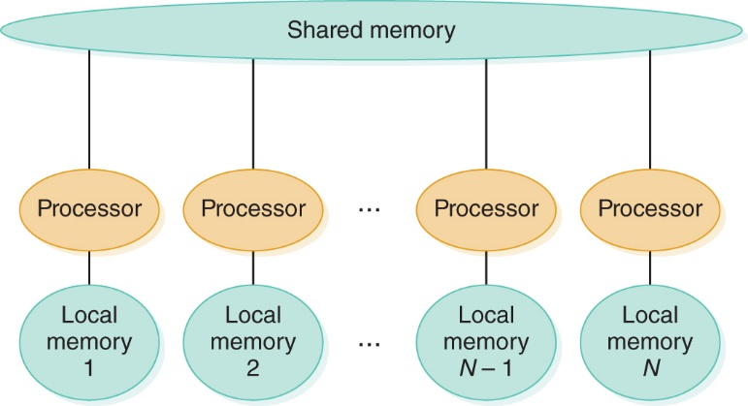
Shared Memory Parallel Processor
Communicate through shared memory
A shared-memory parallel processor

Slide 33
Ethical Issues
Is Privacy a Thing of the Past?
What does Austin Bay say about the printing press? The camera? The telegraph? The telephone?
Do you agree that personal privacy is “all but dead and gone”?
What, if anything, needs to be done about it?
What does Bay say about the future of institutional and state secrecy?

Slide 34
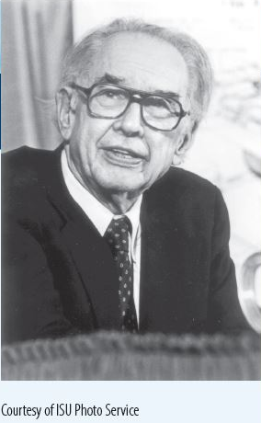
Who Am I?
A lawsuit determined my
legacy.
What was it all about?

Slide 35
Do You Know?
Maurice Wilkes made what far-reaching discovery within 6 weeks of beginning to program?
What was stolen at Target during the 2013 Christmas shopping season?
Bush received 4,258 votes and Kerry received 260 votes, out of 638 votes cast. How can this discrepancy be explained?
Why have spies infiltrated the fantasy world of virtual games?
What did President Obama refuse to give up?

